Slide 1
GLOBAL ECONOMIC IMPACT
Impact of changes in culture, politics, cross-border trade and
Investment on United States of America
Alethia Spencer
Part 1
Notes:
I will be presenting on impact of changes in culture, politics, cross-border trade and Investment on United States of America.

Slide 2
Introduction and purpose.
Globalization has contributed to an increase in international trade and, therefore, more income from foreign exchange.
Economic agreements between nations have provided more opportunities for the united states as a foreign market is available for export goods and services.
This PowerPoint presentation discusses the impact of the changes in culture, and globalization on the united states economy.
The presentation will also include the country's economic conditions and how the opportunities in the world market for economic expansion.
Notes:
Globalization is the main trend in the world economy and has contributed to major global market changes. It has facilitated international trade, and therefore united states can get more income from foreign exchange. This PowerPoint presentation will explain the shifts in the global market's culture and politics and their impact on the economy of the united states. The presentation will also analyze the economic conditions and future opportunities for growth and expansion.

Slide 3
The economy of the united states.
The economy has undergone different phases since its independence from Britain. It has continued to expand to become a leading economy.
The economy is the fastest-growing in the world, with the highest GDP of $65,112.
It is a mixed economy with different sectors that work harmoniously for the greater good of the economy (Shahbaz, M et al 2019).
The economy's main source of income is the export of goods and services from the country's industries.
Notes:
The economy of the united has experienced different phases of growth since its independence from Britain in 1776. Efforts to promote economic growth faced different challenges throughout with economic depression hitting it hard also. Currently, it is the country with the biggest economy, with a GDP of $65,112. With export being the leading source of income in the united states, international trade has been the priority. Globalization has provided many opportunities for the growth and expansion of the economy.

Slide 4
Trade and investment.
United states engage in trade with countries from all parts of the world. This provides a market for the locally produced goods increasing industrial growth.
Industrialization in the united states has increased at a high rate and hence high rates of production of different goods (Asaad, C. T. 2016).
Economic agreements have been signed between the united states and other developing, providing opportunities for investment and trade to the united states.
Trade and investment opportunities worldwide have accelerated the economic growth of the united states by broadening their sources of income.
Notes:
Trade activities to the United States have increased due to the trade agreement between the US and other developing companies, which guarantee the US as the priority exporter to these countries in exchange for investment in those countries. It is, therefore, a win for the economy from both ends. Export of goods and promotes industrialization as more products will be demanded in the market; hence economic development takes place in the source country.

Slide 5
World politics impact on the economy.
The United States is a powerful nation that shapes political opinion on international issues and has used the position to place itself for economic development strategically.
Peace and security in the world promote trade and investment, as there is the confidence to invest when investors are guaranteed safety and security in the regions (Steiner-Khamsi, G et al 2018).
International relations between countries changes over time and may either positively or negatively affect their economic co-operation and hence economic growth.
International organizations of trade formulate policies that encourage and facilitate trade between countries from different parts of the world.
Notes:
The United States-based on its economic power and therefore uses its political ability to influence the global market and economy for the benefit of its economy. Because each country prefers a trade agreement with a powerful nation, the US is the best choice for developing countries. International peace and security provide an easy opportunity for participating in investment and trade in different parts of the world. Terrorism disrupts trade and investment; hence it's a global threat. The economic partnership is based on the bilateral relations between nations, and any shift in the right or wrong direction has a great impact on the economy.

Slide 6
Impact of technology on the economy of the united states.
Trade has been promoted through online platforms that are used for e-commerce purposes. This has provided opportunities for more income and economic growth.
The United States has exported innovation and inventions in technology, which has been exported to other countries and became another source of income.
Technological innovations have promoted industrialization in the United States by introducing modern methods of production, which are effective and more efficient.
The United States has applied technology in different sectors of the economy, which has boosted its performance.
Notes:
Technology has been an important part of the economy to boost its performance and income generated from the sectors. Different inventions made in the US have been imported to other countries, becoming a source of revenue. Digital business in foreign exchange and other startups has been facilitated for expansion and establishment, which has greatly boosted the economy. Modern forms of production have been incorporated in industries making production efficient.

Slide 7
Government’s policies and impact on the economy.
The government has invested in small and medium enterprises by funding startups with grants and loans; they create employment and are sources of revenue for the state.
The government has created policies that create an enabling environment for business and entrepreneurship to thrive.
The government facilitates the establishment of industries by providing incentives and subsidies to new industries.
The government participates in negotiations for foreign investment and trade on behalf of citizens.
Notes:
Every government of the country since its independence has made efforts to facilitate economic development. Therefore, the policies established are aimed at creating an enabling environment for business and investments to thrive. Grants have been availed for startups and small enterprises to facilitate their operations. The government also initiates and negotiates trade pact with other countries on behalf of private investors.

Slide 8
Advantages and opportunities for the economy of the United States.
Globalization has enabled the country to penetrate and transfer investment into different countries in the world.
With modern technology, the united states can export such technologies to other parts of the world and earn foreign revenue.
The United States high skilled population provides labor supply to the industries in producing goods for exports.
Barrett, C. B et al 2019 argues that economic growth and expansion create employment for citizens in the US.
Notes:
Globalization has eased movements of goods and services across different countries in the world. Therefore the US has an opportunity to trade with more nations and promote investment. The country is a hub for technological innovation, which can be exported to different countries and get revenue. The population of the US gets employment the economic growth in the country.

Slide 9
Advantages and opportunities for the economy of the United States contd.
Economic development reduces government borrowing.
It promotes expenditure on the provision of basic services to the citizens.
Unemployment levels are low and, therefore, high standards of living in the US.
Economic growth increases consumption in the country, and therefore there is economic balance.
Notes:
The United States stands to benefit, especially from the opportunities available in the world market. More taxes are raised and paid to the government from the increased business activities, and therefore, the government has enough to fund the country's expenditure plans. It also facilitates the provision of basic services to the citizens. It improves citizens' living standards and, therefore, high consumption in the country, fighting poverty levels.

Slide 10
conclusion.
Shifts in the culture, politics, and international trade provides opportunities for countries to expand their economy.
Governments should establish policies and measures that encourage investment and entrepreneurship in the country to facilitate economic growth.
Policies formulated by governments should create an enabling environment for local and foreign investment.
According to Yan, J. (2019) technology should be embraced as it can be used to create efficient trading activities that earn foreign exchange.
Notes:
The economic development of a nation depends on the country's cultural and political situations and globally. The government has a critical role in promoting economic growth by creating an enabling environment for investment. Technology is important for globalization to be efficient in improving the economy of a country.

Slide 11
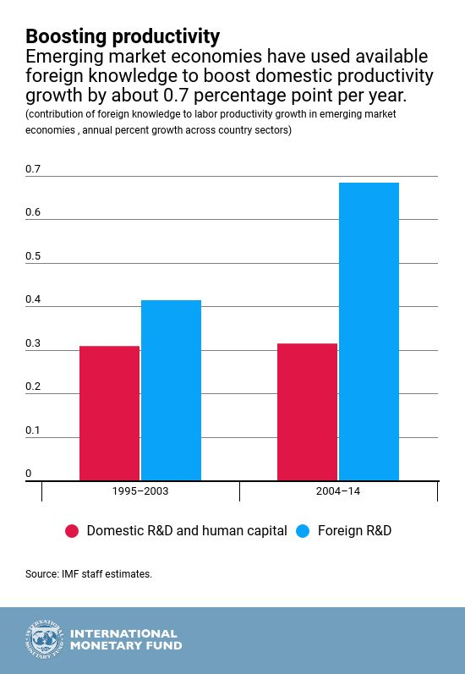
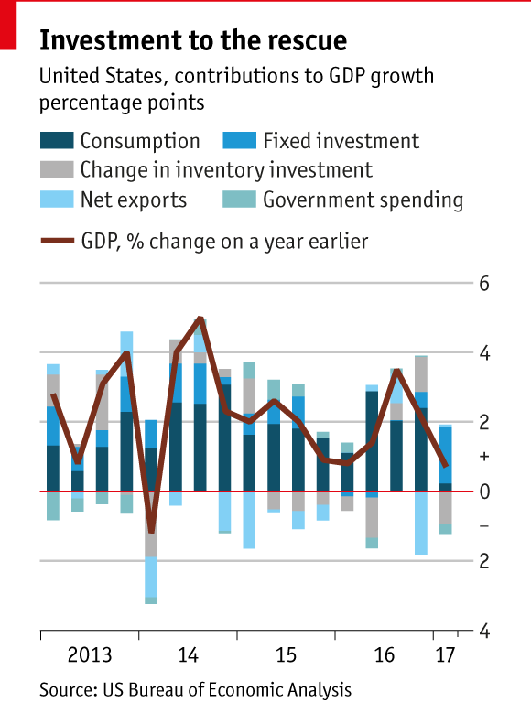
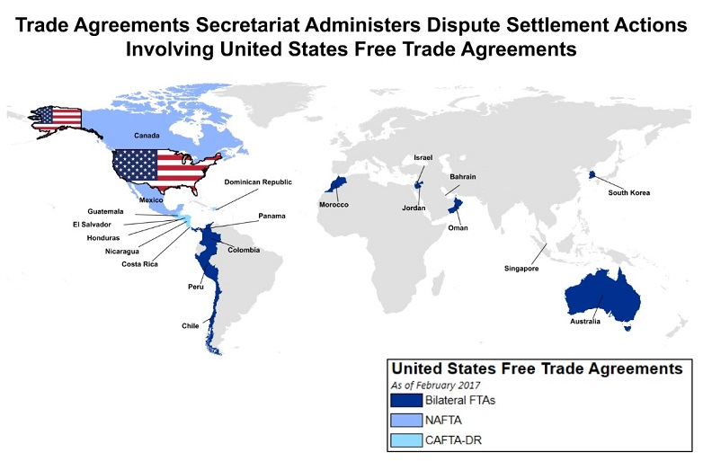
Visuals.

Slide 12
REFERENCES.
Asaad, C. T. (2016). Educational entertainment: Integrating business ethics with out-of-the-classroom financial documentaries. Journal of Financial Education, 42(1-2), 56-80.
Barrett, C. B., Carter, M., Chavas, J. P., & Carter, M. R. (Eds.). (2019). The economics of poverty traps. University of Chicago Press.
https://data.worldbank.org/indicator/NY.GDP.MKTP.CD?locations=US
Shahbaz, M., Ahmed, K., Tiwari, A. K., & Jiao, Z. (2019). Resource curse hypothesis and role of oil prices in USA. Resources Policy, 64, 101514.
Steiner-Khamsi, G., Appleton, M., & Vellani, S. (2018). Understanding business interests in international large-scale student assessments: a media analysis of The Economist, Financial Times, and Wall Street Journal. Oxford Review of Education, 44(2), 190-203.
Yan, J. (2019). Globalization Has Double Sides on Developing Countries: The Benefits and the Harm. Journal of Business and Economic Development, 4(1), 11-14.
https://blogs.imf.org/wp-content/uploads/2018/04/eng-april-3-weoch4-2-4.jpg

